Slide 1
Software Testing
Testing Design Frameworks

Slide 2
Introduction
Key terms and Terminology

Slide 3
Types of Test Framework
General-purpose test framework
Behavioral test framework
Performance Test Framework
User Test Framework
Spring MVC Test Framework

Slide 4
Testing
Testing is the process of checking the functionality of the application whether it is working as per requirements and to ensure that at developer level, unit testing comes into picture.
Unit testing is the testing of single entity (class or method). Unit testing is very essential to every software company to give a quality product to their customers.

Slide 5
Prerequisite
Junit 3 and 4 are the main core of all these test framework
JUnit has driven developers to understand the usefulness of tests, especially of unit tests when compared to any other testing framework. Leveraging a rather simple, pragmatic, and strict architecture, JUnit has been able to "infect" great number of developers

Slide 6
Failure of JUnit 3 and 4
Initially designed to enable unit testing only, not used for all kinds of testing.
Cannot do dependency testing
Poor configuration control (setUp/tearDown)
Intrusive (forces you to extend classes and name your methods a certain way)
Static programming model (forces you to recompile unnecessarily)
The management of different suites of tests in complex projects can be very tricky

Slide 7
General-Purpose Testing

Slide 8
TestNG
TestNG is a testing framework inspired from JUnit and NUnit but introducing some new functionalities that make it more powerful and easier to use
TestNG is an open source automated testing framework; where NG of TestNG means Next Generation. TestNG is similar to JUnit (especially JUnit 4), but its not a JUnit extension. Its inspired by JUnit. It is designed to be better than JUnit, especially when testing integrated classes. The creator of TestNG isCedric Beust.
TestNG eliminates most of the limitations of the older framework and gives the developer the ability to write more flexible and powerful tests. As it heavily borrows from Java Annotations (introduced with JDK 5.0) to define tests, it can also show you how to use this new feature of the Java language in a real production environment.

Slide 9
Features
Annotations.
TestNG uses more Java and OO features.
Supports testing integrated classes (e.g., by default, no need to create a new test class instance for every test method).
Separate compile-time test code from run-time configuration/data info.
Flexible runtime configuration.
Introduces ‘test groups’. Once you have compiled your tests, you can just ask TestNG to run all the "front-end" tests, or "fast", "slow", "database", etc...
Supports Dependent test methods, parallel testing, load testing, partial failure.
Flexible plug-in API.
Support for multi threaded testing.

Slide 10
Installation
Download from http://testng.org/doc/download.html

Slide 11
How to compile?
TestNG can be invoked in several different ways:
With a testng.xml file (any XML filename usually are used)
With ant
From the command line

Slide 12
Test Cases

Slide 13
Steps in Writing Test Cases
Write the business logic of your test and insert TestNG annotations in your code..
Add the information about your test (e.g. the class name, the groups you wish to run, etc...) in a testng.xml file or in build.xml..
Run TestNG.

Slide 14
The testng.xml
<?xml version="1.0" encoding="UTF-8"?>
<!DOCTYPE suite SYSTEM "http://testng.org/testng-1.0.dtd" >
<suite name="Suite1">
<test name="test1">
<classes>
<class name=“org.orion.training.codes.TestEmployeeDetails"/>
</classes>
</test>
</suite>

Slide 15
The testing.xml…
A suite is represented by one XML file. It can contain one or more tests and is defined by the <suite> tag.
Tag <test> represents one test and can contain one or more TestNG classes.
<class> tag represents a TestNG class is a Java class that contains at least one TestNG annotation. It can contain one or more test methods.

Slide 16
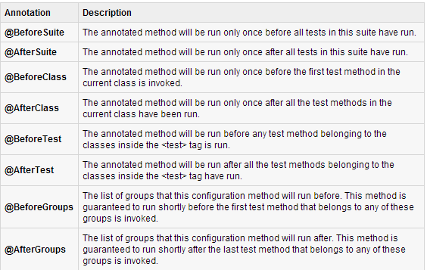
Annotations

Slide 17
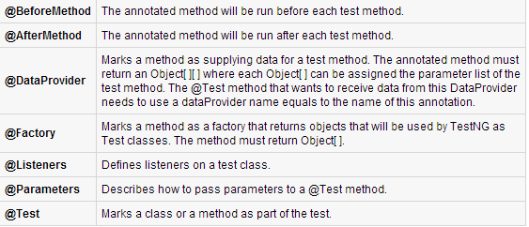
Annotations…

Slide 18
Benefits of Annotations
TestNG identifies the methods it is interested in by looking up annotations. Hence, method names are not restricted to any pattern or format.
We can pass additional parameters to annotations.
Annotations are strongly typed, so the compiler will flag any mistakes right away.
Test classes no longer need to extend anything (such as TestCase, for JUnit 3).

Slide 19
Annotations Execution
First of all beforeSuite() method is executed only once.
Lastly, the afterSuite() method executes only once.
Even the methods beforeTest(), beforeClass(), afterClass() and afterTest() methods are executed only once.
beforeMethod() method executes for each test case but before executing the test case.
afterMethod() method executes for each test case but after the execution of test case.
In between beforeMethod() and afterMethod() each test case executes.

Slide 20
The TestNG class
The test cases are executed using TestNG class.
This class is the main entry point for running tests in the TestNG framework. Users can create their own TestNG object and invoke it in many different ways:
On an existing testng.xml
On a synthetic testng.xml, created entirely from Java
By directly setting the test classes (customized by you!)

Slide 21
The TestNG class
You can also define which groups to include or exclude, assign parameters, etc. The command line parameters are:
-d outputdir: specify the output directory
-testclass class_name: specifies one or several class names
-testjar jar_name: specifies the jar containing the tests
-sourcedir src1;src2: ; separated list of source directories (used only when javadoc annotations are used)
-target
-groups
-testrunfactory
-listener

Slide 22
Suite Testing
A Test suite is a collection of test cases that are intended to test a behavior or set of behaviors of software program. In TestNG, we cannot define a suite in testing source code, but it is represented by one XML file as suite is the feature of execution.
This also allows flexible configuration of the tests to be run. A suite can contain one or more tests and is defined by the <suite> tag.
<suite> is a root tag of your testng.xml. It describes a test suite, which in turn is made of several <test> sections.

Slide 23
The Suite
<?xml version="1.0" encoding="UTF-8"?>
<!DOCTYPE suite SYSTEM "http://testng.org/testng-1.0.dtd" >
<suite name="Suite1">
<test name="exampletest1">
<classes>
<class name="Test1" />
</classes>
</test>
<test name="exampletest2">
<classes>
<class name="Test2" />
</classes>
</test>
</suite>

Slide 24
Ignore Tests
Sometimes, it happens that our code is not ready and test case written to test that method/code will fail if run. In such cases, annotation @Test(enabled = false) helps to disable this test case
A test method is annotated with @Test(enabled = false), then the test case that is not ready to test is bypassed

Slide 25
Group Tests
The group test is a new innovative feature in TestNG, it doesn’t exist in JUnit framework, it permits you dispatch methods into proper portions and perform sophisticated groupings of test methods.
This gives you maximum flexibility in how you partition your tests and doesn't require you to recompile anything if you want to run two different sets of tests back to back.
Groups are specified in your testng.xml file using the <groups> tag. It can be found either under the <test> or <suite> tag. Groups specified in the <suite> tag apply to all the <test> tags underneath.

Slide 26
Exception Testing
Sometimes, you may need to invoke methods in a Test case in a particular order or you want to share some data and state between methods. This kind of dependency is supported by TestNG as it supports the declaration of explicit dependencies between test methods.
TestNG allows you to specify dependencies either with:
Using attributes dependsOnMethods in @Test annotations OR
Using attributes dependsOnGroups in @Test annotations.
When exception is ecnountered during dependency, everything halts

Slide 27
Parameterized Testing
Another interesting feature available in TestNG is parametric testing. In most cases, you'll come across a scenario where the business logic requires a hugely varying number of tests. Parameterized tests allow developers to run the same test over and over again using different values.
TestNG lets you pass parameters directly to your test methods in two different ways:
With testng.xml
With Data Providers

Slide 28
Parameter Pass with XML
With this technique, you define the simple parameters in the testng.xml file and then reference those parameters in source files

Slide 29
Type Issues
TestNG will automatically try to convert the value specified in testng.xml to the type of your parameter. Here are the types supported:
String
int/Integer
boolean/Boolean
byte/Byte
char/Character
double/Double
float/Float
long/Long
short/Short

Slide 30
Parameter Pass with Dataproviders
A Data Provider is a method annotated with @DataProvider. This annotation has only one string attribute: its name. If the name is not supplied, the Data Provider’s name automatically defaults to the method’s name. A Data Provider returns an array of objects

Slide 31
Mocking

Slide 32
Mocking
Redefining the behavior of an object or method to imitate or modify the original implementation to accommodate our test cases
Behavior Testing in some references

Slide 33
JMockit
JMockit is one of the many mocking frameworks available for unit testing in Java. If you have to unit test you'll invariably end up mocking objects for third party classes and for stubbing.
Based from java.lang.Proxy object
Easiest to learn among mocking frameworks
Some mocking frameworks:
Jmock
EasyMock

Slide 34
Characteristics
Interface-dependent
Dependency-injection principle

Slide 35
Fixture
Uses setupMock()

Slide 36
Installation
Download JAR files from https://code.google.com/p/jmockit/

Slide 37
Code Coverage
Simply a measurement of what code has been actually run when tests are executed.
Like testing itself, code coverage measurement is probably not done enough, or misused.
Has Path coverage

Slide 38
Reporting Issues
Path
Measures how many of the possible execution paths through method/constructor bodies were actually executed by tests. The percentages are calculated as 100*NPE/NP, where NP is the number of possible paths and NPE the number of fully executed paths.
Line
Measures how much of the executable production code was exercised by tests. An executable line of code contains one or more executable segments. The percentages are calculated as 100*NE/NS, where NS is the number of segments and NE the number of executed segments.
Data
Measures how many of the instance and static non-final fields were fully exercised by the test run. To be fully exercised, a field must have the last value assigned to it read by at least one test. The percentages are calculated as 100*NFE/NF, where NF is the number of non-final fields and NFE the number of fully exercised fields.

Slide 39
Mocking Constructor
@Test
public void testGetName() {
new MockUp<Person>() {
@Mock
public void $init() {
//Dont assign name variable at all
//Leave it null
}
};
Person p = new Person();
String name = p.getName();
assertNull("Name of person is null",name);
}
}

Slide 40
Mocking Constructor with Param
public class PersonTestConstructor {
@Test
public void testGetName() {
new MockUp<Person>() {
@Mock
public void $init(String name) {
//Dont assign name variable at all
//Leave it null
}
};
Person p = new Person("AbhiJMockit");
String name = p.getName();
System.out.println(name);
assertNull("Name of person is null",name);
}
}

Slide 41
Mocking Static IB
public class BankTest {
@Test
public void testBankStaticBlock(){
new MockUp<Bank>(){
@SuppressWarnings("unused")
@Mock
public void $clinit(){
Bank.updateBalance(500);
}
};
assertEquals("The balance amount is 500", 500, Bank.balanceAmount);
}
}

Slide 42
Mocking public Methods
Here are two ways to can do it:
Behavior Based Testing or using the Expectations class.
State Based Testing using the MockUp apis

Slide 43
Mocking public Methods…
/**************** DBManager.java *************/
public class DBManager {
public String retrieveAccountHolderName(int accountId ){
String accountHolderName = null;
//connect to db
//retrieve the Account Holder Name
return accountHolderName;
}
}

Slide 44
Mocking public Methods…
/**************** Bank.java ****************/
public class Bank {
DBManager dbManager =new DBManager();
public String processAccount(int accountID){
//Some other code goes here
String accountHolderName = dbManager.retrieveAccountHolderName(accountID);
//some more processing code
return accountHolderName;
}
}

Slide 45
Mocking public Methods…
/*************** BankTest.java ****************/
public class BankTest {
@Test
public void testRetrieveAccountHolderName() {
Bank bank = new Bank();
// Define the Expectations block here
new Expectations() {
DBManager dbManager; // variables declared here are mocked by default
{
dbManager.retrieveAccountHolderName(10);
returns("Anna");
}
};
String name = bank.processAccount(10);
assertEquals("Account holder Name for A/C id 10 is 'Anna’ ","Anna",name);
}
}

Slide 46
Mock Private Methods
Here are two ways to can do it:
Behavior Based Testing or using the Expectations class.
State Based Testing using the MockUp apis
Uses the Reflection Utility called the Deencapsulation class

Slide 47
Mock Private Methods…
/****************** Simple.java ***********/
public class Simple {
private String iAmPrivate(){
return "Private Method";
}
public String publicCallsPrivate(){
return iAmPrivate();
}
}

Slide 48
Mock Private Methods…
/**************** SimpleTest.java *********/
public class SimpleTest {
@Test
public void testPublicInvokesPrivate(){
//Make simple final to be used in the Expectations inner class
final Simple simple = new Simple();
//pass simple as argument to make it a Mocked type
//in the Expectations class
new Expectations(simple){
{
Deencapsulation.invoke(simple, "iAmPrivate");
returns("I got INVOKED");
}
};
String str = simple.publicCallsPrivate();
assertEquals("The returned string is - I got INVOKED","I got INVOKED",str);
}
}

Slide 49
Mocking Static Methods
/********** DBManager.java **************/
public class DBManager {
public static String getConnectionString(){
return "ORIGINAL";
}
}

Slide 50
Mocking Static Methods…
/********** Bank.java **************/
public class Bank {
public String makeConnection(){
//some connection related code
//goes here
// call to static method
String conStr = DBManager.getConnectionString();
// If the connection String
// is anything other than
// ORIGINAL return FAIL
if(conStr.equals("ORIGINAL"))
return "SUCCESS";
else
return "FAIL";
}
}

Slide 51
Mocking Static Methods…
/********** BankTest.java **************/
public class BankTest {
@Test
public void testMakeConnection(){
new NonStrictExpectations(){
// DBManager is mocked here
DBManager dbManager;
{
DBManager.getConnectionString();
returns("DUPLICATE");
}
};
Bank bank = new Bank();
String status = bank.makeConnection();
assertEquals("Status is FAIL","FAIL",status);
}
}

Slide 52
Throwing Exceptions
/********** Bank.java **************/
public class Bank {
public String getConnection() throws Exception{
return "Connection";
//some thing here might throw an exception
}
}

Slide 53
Throwing Exceptions…
/********** BankTest.java **********/
public class BankTest {
@Test(expected=Exception.class)
public void testGetConnection() throws Exception{
final Bank bank = new Bank();
new Expectations(bank){
{
bank.getConnection();
result = new Exception();
}
};
bank.getConnection();
}
}

Slide 54
JMockit Verifications
As the name suggests this class is used to “verify” something after a test method call has taken place.
Extending the record-replay model, it becomes record-replay-verify model. Verifications can be used to explicitly check if a call has been made and how many times

Slide 55
Verification
/************* "Person.java" *********/
public class Person {
String name = "Abhi" ;
public String getName() {
return name;
}
public void setName(String name) {
this.name = name;
}
}

Slide 56
Verification…
/************* "Department.java" *********/
public class Department{
Person person = new Person();
//Person is the 'collaborator'- a fancy name for third
// party object
public String getPersonName(){
return person.getName();
}
}

Slide 57
Verification…
/************* "DepartmentTest.java" *********/
public class DepartmentTest{
@Mocked
Person person;//The mocked object. Note that I am NOT using new to create an instance.
@Test
public void testGetNameCalls(){
Department dept = new Department();
String name = dept.getPersonName();
new Verifications(){
{
person.getName();//verify that this method is called when dept.getPersonName() is invoked
}
};
}
}

Slide 58
Spring MVC Test

Slide 59
Mockito
Mockito is a popular mock framework which can be used in conjunction with JUnit. Mockito allows you to create and configure mock objects.
Mockito supports the creation of mock objects with the static mock() method call. It also supports the creation of mock objects based on the @Mock annotation.
If you use annotations, you must initialize this mock objects with aMockitoAnnotations.initMocks(this) method call.

Slide 60
Mockito and Spring
In testing Spring MVC, we need aMockito framework:
MockitoAnnotations.initMocks(this) scans the class annotation, instanciates invoiceDaoMock and inject it into the InvoiceService bean.
when(.(any())).thenReturn() associates a return value with method execution parameters.
If no return value use when…thenAnswer()

Slide 61
Installation
Download JAR files here https://code.google.com/p/mockito/

Slide 62
Sample
public class MockitoTest {
// assume there is a class MyDatabase
@Mock
MyDatabase databaseMock;
@Before
protected void setUp() throws Exception {
MockitoAnnotations.initMocks(this);
}

Slide 63
@Test
public void testQuery() {
// assume there is a class called ClassToTest
// which could be tested
ClassToTest t = new ClassToTest(databaseMock);
// call a method
boolean check = t.query(" from t");
// test the return type
assertTrue(check);
// test that the query() method on the
// mock object was called
Mockito.verify(mock).query(" from t");
}
}

Slide 64
Limitations
Mockito has certain limitations. It can not test the following constructs:
final classes
anonymous classes
primitive types

Slide 65
Configuring the mock objects
Mockito has a fluent API. You can use the verify() method to ensure that a method was called.
when(....).thenReturn(....) can be used to specify a condition and a return value for this condition.

Slide 66
Sample
@Test
public void test1() {
MyClass test = Mockito.mock(MyClass.class);
// define return value for method getUniqueId()
test.when(test.getUniqueId()).thenReturn(43);
// TODO use mock in test....
}

Slide 67
Verify the calls on the mock objects
Mockito keeps track of all the method calls and their parameters to the mock object. You can use the verify()method on the mock object to verify that the specified conditions are met, i.e., that a method has been called with certain parameters. (Behavior Testing)

Slide 68
Sample
@Test
public void testSpring() {
MyClass test = Mockito.mock(MyClass.class);
// define return value for method getUniqueId()
test.when(test.getUniqueId()).thenReturn(43);
// TODO use mock in test....
// now check if method testing was called with the parameter 12
Mockito.verify(test).testing(Matchers.eq(12));
// was the method called twice?
Mockito.verify(test, Mockito.times(2));
}

Slide 69
Sample
public class SampleServiceImpl implements SampleService {
private UserDao userDao;
@Autowired
public SampleServiceImpl(UserDao userDao) {
this.userDao = userDao;
}
public SignupForm saveFrom(SignupForm signupForm) throws InvalidUserException{
String firstName = signupForm.getFirstName();
if(!StringUtils.isEmpty(firstName) && "Dave".equalsIgnoreCase(firstName)) {
throw new InvalidUserException("Sorry Dave");
}

Slide 70
Sample…
User user = new User();
user.setFirstName(signupForm.getFirstName());
user.setEmail(signupForm.getEmail());
user.setLastName(signupForm.getLastName());
user = userDao.save(user);
signupForm.setId(user.getId());
return signupForm;
}
}

Slide 71
public class SampleServiceTest {
private UserDao userDao;
private SampleService sampleService;
@Before
public void doSetup() {
userDao = mock(UserDao.class);
sampleService = new SampleServiceImpl(userDao);
}

Slide 72
Other samples…
// Normal save, return id
when(someDao.save("first")).thenReturn(1);
// Another save but return a different id
when(someDao.save("second")).thenReturn(2);
// Get exception
when(someDao.save("third")).thenThrow(new DataAccessException("this is expected for third"));

Slide 73
Exceptions
@Test(expected = InvalidUserException.class)
public void testInvalidUserException() {
SignupForm signupForm = new SignupForm();
signupForm.setLastName("formLast");
signupForm.setFirstName("Dave");
signupForm.setEmail("form@test.com")
sampleService.saveFrom(signupForm);
}

Slide 74
Sample
@Test
public void testSaveForm() {
SignupForm signupForm = new SignupForm();
signupForm.setLastName("formLast");
signupForm.setFirstName("formFirst");
signupForm.setEmail("form@test.com");

Slide 75
when(userDao.save(any(User.class)))
.thenAnswer(new Answer<User>() {
@Override
public User answer(InvocationOnMock
invocation) throws Throwable {
User user = (User)
invocation.getArguments()[0];
user.setId(1L);
return user;
}
});

Slide 76
assertNull(signupForm.getId());
signupForm =
sampleService.saveFrom(signupForm);
assertNotNull(signupForm.getId());
assertTrue(signupForm.getId() > 0);
}
}

Slide 77
Groovy Grails Testing

Slide 78
Mockfor
When writing Grails unit tests it’s often very useful to use mock objects, especially when testing service calls from controllers. Grails includes built-in support for mock objects via mockFor
The mockFor mock objects support the full mock lifecycle: record, play, and verify

Slide 79
class BankController {
BankService bankService
NotificationService notificationService
def removeAccount(String accountName) {
boolean removalResult =
bankService.removeAccount(accountName)
if (removalResult) {
notificationService.notifyAccountHolder(accountName,
NotificationType.ACCOUNT_REMOVAL)
}
}
}

Slide 80
mockFor
@Test
void mockForTestCase() {
def bankServiceControl = mockFor(BankService)
bankServiceControl.demand.removeAccount(1..1) {
String accountName -> return true
}
def notificationServiceControl = mockFor(NotificationService)
notificationServiceControl.demand.notifyAccountHolder(1..1) {
String accountName, NotificationType notificationType ->
}
controller.bankService = bankServiceControl.createMock()
controller.notificationService =
notificationServiceControl.createMock()
controller.removeAccount("AccountToRemove")
bankServiceControl.verify()
notificationServiceControl.verify()
}

Slide 81
Performance Testing

Slide 82
JMeter
Jmeter is a popular open source performance testing tool
The Apache JMeter is pure Java open source software, which was first developed by Stefano Mazzocchi of the Apache Software Foundation, designed to load test functional behavior and measure performance

Slide 83

Why JMeter?

Slide 84
Benefits
Open source license: JMeter is totally free, allows developer use the source code for the development
Friendly GUI: JMeter is extremely easy to use and doesn't take time to get familiar with it
Platform independent: JMeter is 100% pure Java desktop application. So it can run on multiple platforms
Full multi-threading framework. JMeter allows concurrent and simultaneous sampling of different functions by a separate thread group
Visualize Test Result: Test result can be display in a different format such as chart, table, tree and log file
Easy installation: You just copy and run the *.bat file to run JMeter. No installation needed.
Highly Extensible: You can write your own tests. JMeter also supports visualization plugins allow you extend your testing

Slide 85
Benefits…
Multiple testing strategy: JMeter supports many testing strategies such as Load Testing, Distributed Testing, and Functional Testing.
Simulation: JMeter can simulate multiple users with concurrent threads, create a heavy load against web application under test
Support multi-protocol: JMeter does not only support web application testing, but also evaluate database server performance. All basic protocols such as HTTP, JDBC, LDAP, SOAP, JMS, and FTP are supported by JMeter
Record & Playback - Record the user activity on the browser and simulate them in web application using JMeter
Script Test: Jmeter can be integrated with Bean Shell & Selenium for automated testing.

Slide 86
How does it work?
JMeter simulates a group of users sending requests to a target server, and return statistics information of target server through graphical diagrams

Slide 87
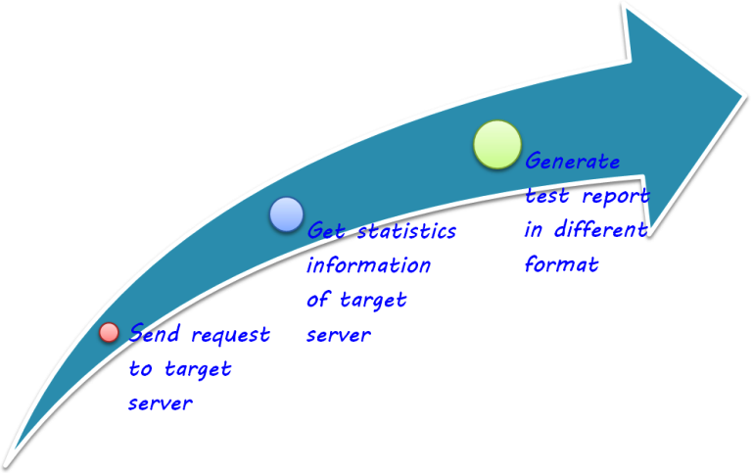
Process

Slide 88
Installation
Meter is a pure Java application and should run correctly on any system that has a compatible Java implementation.
Download the JMeter application here http://jmeter.apache.org/download_jmeter.cgi
Simply unzip the zip/tar file into the directory where you want JMeter to be installed

Slide 89
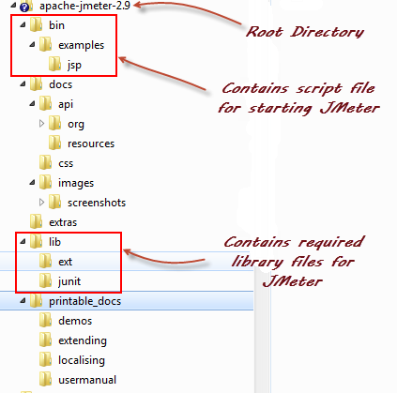
JMeter Installation Folder

Slide 90
bin: Contains JMeter script file for starting JMeter
/docs: JMeter documentation files
/extras: ant related extra files
/lib/: Contains the required Java library for JMeter
/lib/ext: contains the core jar files for JMeter and the protocols
/lib/junit: JUnit library used for JMeter
/printable_docs: syempre docs ☺

Slide 91
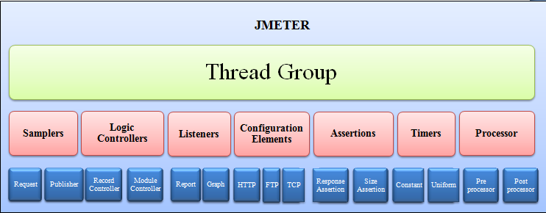
JMeter Platform

Slide 92
Thread Group
Thread Groups is a collection of Threads. Each thread represents one user using the application under test. Basically each Thread simulates one real user request to the server.
The controls for a thread group allow you to Set the number of threads for each group.

Slide 93
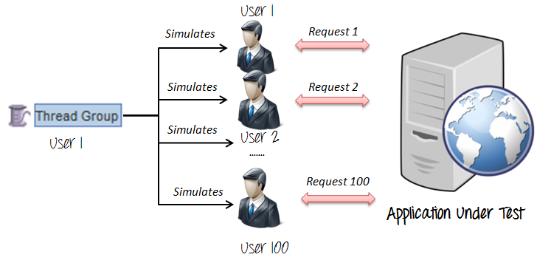
Thread Group

Slide 94
Samplers
As we know already that JMeter supports testing HTTP, FTP , JDBC and many other protocols.
We already know that Thread Groups simulate user request to the server
But how does a Thread Group know which type of requests (HTTP, FTP etc.) it needs to make ?
Samplers!!! ☺
The user request could be FTP Request, HTTP Request, JDBC Request...Etc.

Slide 95
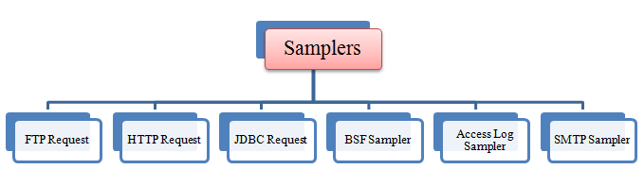

Slide 96
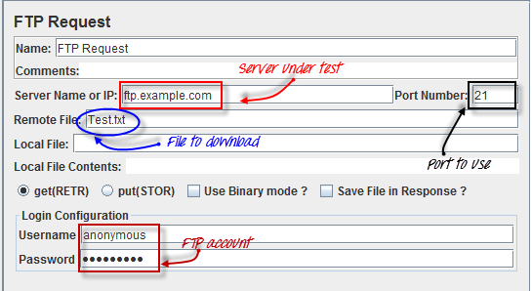
FTP request

Slide 97
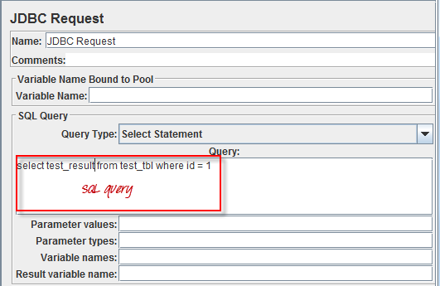
JDBC Request

Slide 98
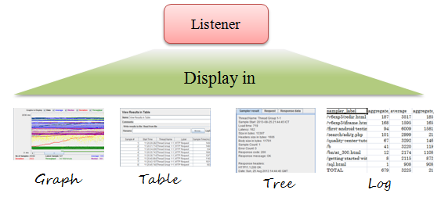
Listeners
Listeners: shows the results of the test execution. They can show results in different format such as tree, table, graph or log file

Slide 99
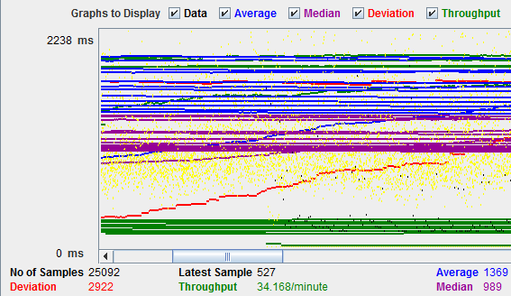
Graph Result

Slide 100
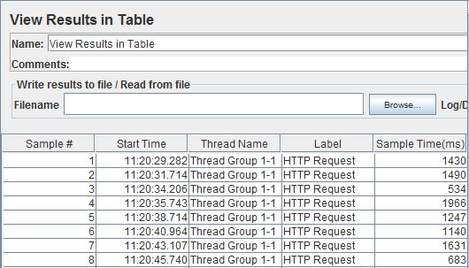
Table Result

Slide 101
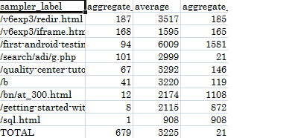
Text File Result

Slide 102
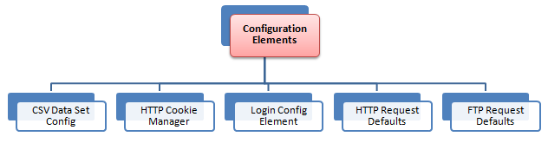
Configuration Elements
set up defaults and variables for later use by samplers.

Slide 103
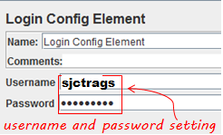
Login Config

Slide 104
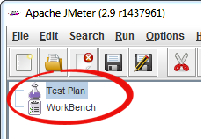
JMeter Features
Test Plan
Workbench

Slide 105
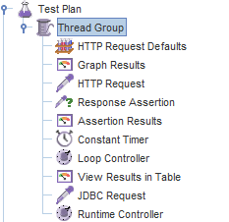
Test Plan
Test Plan is where you add elements required for your JMeter Test.
It stores all the elements (like ThreadGroup, Timers etc) and their corresponding settings required to run your desired Tests.

Slide 106
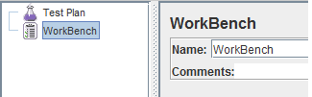
Workbench
The WorkBench simply provides a place to store test elements temporarily. WorkBench has no relation with Test Plan.
JMeter will not save the contents of the WorkBench. It only saves the contents of the Test Plan branch

Slide 107
Selenium

Slide 108
What is Selenium?
Test tool for web applications
Runs in any mainstream browser
Supports tests in many languages
Selenese (pure HTML, no backend required)
Java, C#, Perl, Python, Ruby
Record/playback (Selenium IDE)
Open Source with corporate backing

Slide 109
Benefit
Web application progressive testing

Slide 110
Installation
Install Firefox
Install Java jdk
Main TOOLS Installation:
Install Selenium IDE
After installation - you should see selenium ide option in firefox.
Install Selenium RC

Slide 111
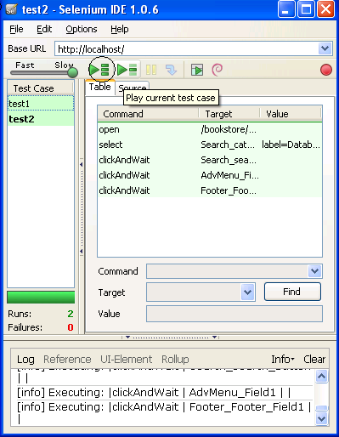
Creating Test Suite
In the Selenium IDE you can create any number of test cases and save them as test suite.
To Run the test Suite click on the “Play entire test suite” button as shown below.

Slide 112
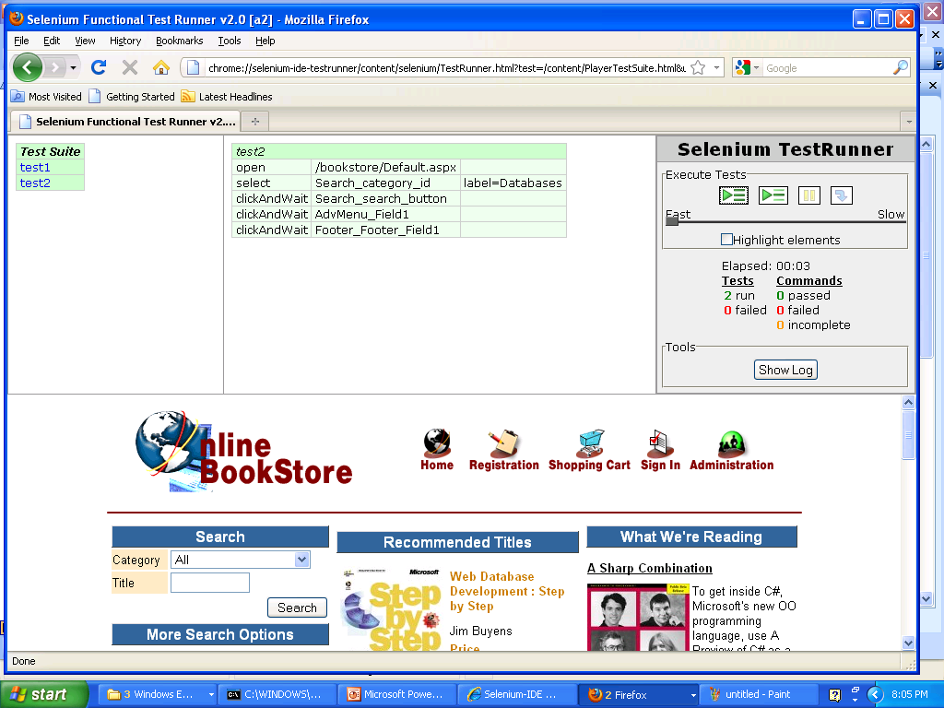
Test Runner
Click this button to run all the tests

Slide 113
Running Options
Run a Test Case
Click the Run button to run the currently displayed test case.
Run a Test Suite
Click the Run All button to run all the test cases in the currently loaded test suite.
Stop and Start
The Pause button can be used to stop the test case while it is running. The icon of this button then changes to indicate the Resume button. To continue click Resume.
Stop in the Middle
You can set a breakpoint in the test case to cause it to stop on a particular command. This is useful for debugging your test case. To set a breakpoint, select a command, right-click, and from the context menu select Toggle Breakpoint.

